Slide 1
Building Office Add-ins for Microsoft Word
Working with HTML, Images and Tables

Slide 2

Working with HTML, Images and Tables
HTML
Images
Tables
Demo

Slide 3
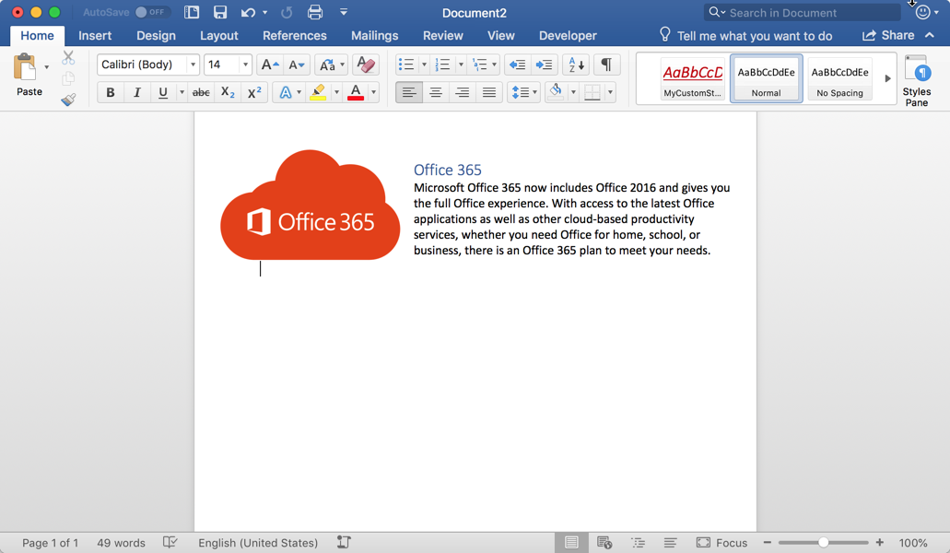
HTML in Word
Why HTML
Many developers will find it easier to interact with a Word document as HTML rather than Open Office XML (OOXML).
Office.js allows content to be written to or read from a document as HTML.
The document body, paragraphs, and ranges can all be manipulated as HTML using the getHtml and insertHtml operations.
Notes:
Modern Office add-ins are built with web technologies, so many add-in developers may find it easier to work with a Word document as HTML rather than the Open Office XML representation which tends to be somewhat cryptic and difficult to decipher
Office.js allows content to be written to or read from a document as HTML
The document body, paragraphs, and ranges can be manipulated as HTML using the getHtml and insertHtml operations.

Slide 4
HTML in Word
// Inserts an HTML block at the end of a paragraph (also valid for body and range)
paragraph.insertHtml('<p style="font-family: verdana;">Inserted HTML.</p><p>Another paragraph</p>', "End");
// Get the HTML representation of the paragraph object (also valid for body and range)
var html = paragraph.getHtml();
Notes:
The first sample here is inserting a few paragraphs as HTML to the end of an existing paragraph
The second sample is reading a paragraph as HTML

Slide 5
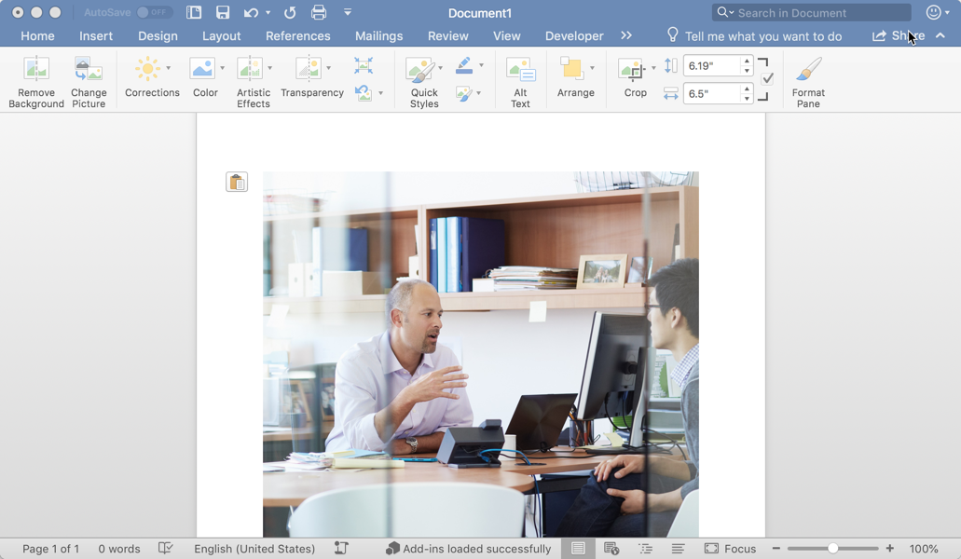
Images
Images
Images can be challenging to work with in JavaScript, but Office.js allows images to be manipulated as base64 encoded strings.
Images can be inserted into the body, paragraphs, or ranges of a document. All of these objects have an inlinePictures collection.
Office.js allows you to manipulate how the images is displayed in the document through properties such as lockAspectRatio, height, width, and more.
Notes:
Images can be difficult to work with in JavaScript, especially in a binary form. Office.js makes it easy to work with images in a Word document by exposing them in their base64 encoded string representation
Images can be inserted in the body, paragraph, or ranges of a document.
Each of these objects contains a inlineImages collection
Office.js can be used to manipulate how images are displayed in a document, including the height, width and aspect ratios.

Slide 6
Images
// Get all inline pictures in body (also valid for paragraph or range)
const images = body.inlinePictures;
// Insert an image from base64 encoded string (insertLocation support “Start”, “End”)
context.document.body.insertInlinePictureFromBase64(base64Image, "End");
// Retrieves the base64 encoded string of an inline picture
var base64 = someInlinePicture.getBase64ImageSrc();
// Locks the aspect ratio and sets the width of an inline picture
someInlinePicture.lockAspectRatio = true;
someInlinePicture.width = 400;
Notes:
The first sample is getting all the inlinePictures in the body of the document
The second sample is inserting an image at the end of the body using a base64 string representation of the image
Next, you see how to read the base64 representation of an image using the getBase64ImageSrc function
Finally, we see how to lock the aspect ratio of an image and modify it’s width

Slide 7
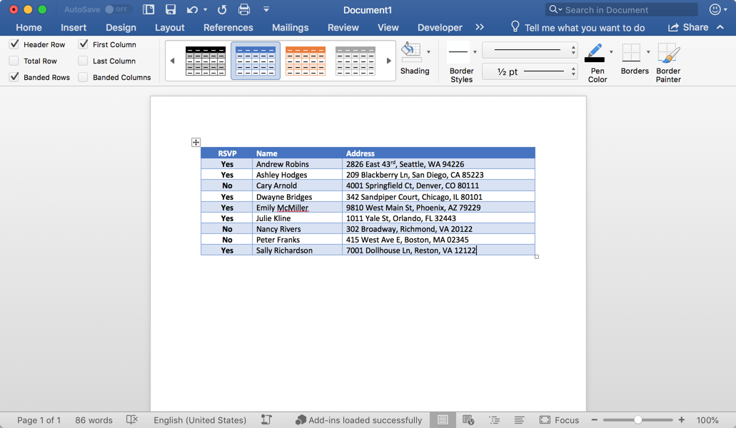
Tables
Tables
Office.js allows a table to be inserted relative to paragraphs, ranges and the body of a document.
The insertTable function specifies the dimensions of the table, the insert location, and a 2D array of values.
The tables property allows tables to be accessed and manipulated in JavaScript on body and range objects.
It is important to note that tables can be inserted relative to a paragraph, but a table does not exist within a paragraph (this is different from an inlinePicture).
Notes:
Office.js allows tables to be inserted relative to paragraphs, ranges, and the body of a document.
The insertTable function accepts the table dimensions, the insert location, and a 2D array of data to display in the table
Only the document body and ranges expose a table collection property as tables do not exist within a paragraph, only relative to a paragraph.

Slide 8
Tables
// Get all tables in body (also valid for range)
const originalRange = body.tables;
// Inserts a 3x3 table into the paragraph
const tableData = [
["Name", "ID", "Birth City"],
["Bob", "434", "Chicago"],
["Sue", "719", "Havana"],
];
paragraph.insertTable(3, 3, "After", tableData);
// Get the number of rows in a table
var rows = table.rowCount;
// Gets the values from a table as a 2D array
var array2D = table.values;
Notes:
The first sample retrieves all the tables in the body of a document.
The second sample is inserting a 3x3 table with data after a paragraph
The final two samples show you how to retrieve specific properties of a table such as the rowCount and actual table data as a 2D array.

Slide 9
Demo
Notes:
In this demo, we will look at an add-in for Microsoft Word that manipulates HTML, images, and tables
Open the completed solution located in the Demos/04 All Complete folder
Run npm install
Run npm run build
Run npm start
Side-load the add-in
Launch the add-in using the Show Taskpane button in the ribbon
Click Insert Image to insert an image
Click Insert HTML to insert rich HTML
Click Insert Table to insert a table into the document

Slide 10

Summary
HTML, images, and tables are powerful Office.js capabilities for creating attractive documents.
Office.js uses the base64 encoded string representation of inline pictures to make manipulation easy with JavaScript.
Tables are a first class citizen in Office.js and can be written to and read from with 2D string arrays

Slide 11
Reading further
Word Add-ins overview
https://docs.microsoft.com/en-us/office/dev/add-ins/word/word-add-ins-programming-overview
Word JavaScript API reference
https://docs.microsoft.com/en-us/office/dev/add-ins/word/
Word Add-in samples
https://github.com/OfficeDev?utf8=%E2%9C%93&q=word
InlinePicture and Table objects
https://docs.microsoft.com/en-us/javascript/api/word/word.inlinepicture
https://docs.microsoft.com/en-us/javascript/api/word/word.table

Slide 12
Thank you

